Slide 1
Machine Learning Engineering-Chatper 1
Reading Notes

Slide 2
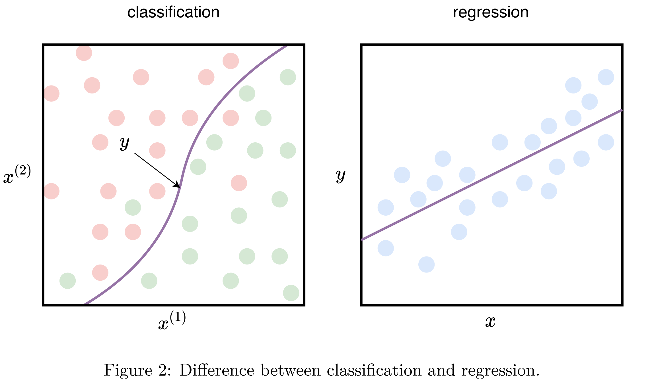
1.2.1 Supervised Learning
x: feature vector (input), y: label (output)
Classification: need a line separating examples of different classes;
Regression: find a line that closely follows the training examples.
(x₁, y₁)
(x₂, y₂)
...
(x_{D}, y_{D})
x₁: [weight, height, gender, ...] for person 1
x₂: [weight, height, gender, ...] for person 2
...
x_{D}: [weight, height, gender, ...] for person D
attribute 1
attribute 2
yi: one element in a class {1,2, ..., C}

Slide 3
1.2.2 Unsupervised Learning
examples {x₁, x₂, ..., x_{N}} are unlabeled
e.g. clustering, dimensionality reduction, outlier detection
≈supervised
unlabeled >> labeled examples
unlabeled examples: for the algorithm to produce a better model
1.2.3 Semi-supervised Learning

Slide 4
1.2.4 Reinforcement Learning
the machine/agent lives in an environment and perceive the state of that environment as a feature vector;
to learn an optimal policy that outputs an optimal action, by maximizing the expected average long-term rewards, taking the feature vector of a state as input;
apply condition:
i. decision making is sequential,
ii. the goal is long-term,
iii. non-terminal states of the environment.

Slide 5
1.3.1 Direct vs. Indirect Data
direct: data used to create training examples (i.e. feature vectors) in order to train the model;
indirect: data used to enrich/enhance those examples, but not to create new ones (only add more information to the existing training examples);
e.g. additional attributes, distinguishing attributes, binary attributes...

Slide 6
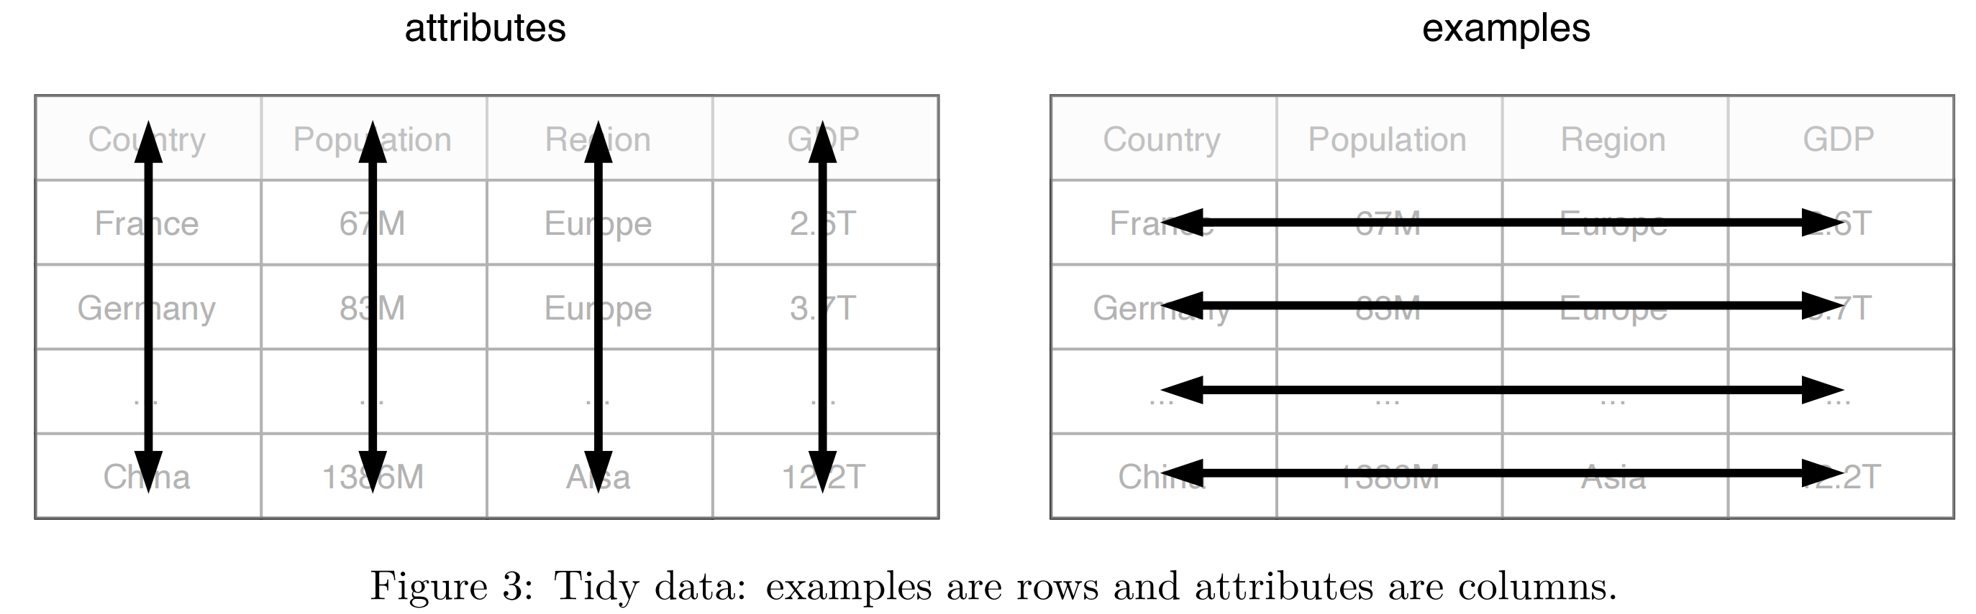
1.3.2 Raw vs. Tidy Data
Raw: in their natural form, not be transformed into a feature vector, may not be employable for ML;
Tidy: a spreadsheet with each row for one example, each column for an attribute; to make the data employable in ML, feature engineering transforms each raw example into a feature vector x.
Most algorithms only accept training data in the form of numerical feature vectors, not categorical (while decision tree algorithm can do it)

Slide 7
1.3. Training and Holdout Sets
Three types of examples:
(1) training set (the biggest one; used to produce the model);
(2) validation set (similar size with test, smaller than training);
(3) test set (used to assess the model);
Validation set:
I. to choose the learning algorithm with the best performance on the unseen data;
II. to find the best configuration values (i.e. hyperparameters) for that learning algorithm.
Seen vs. unseen:
we want the model to be good at predicting examples that the learning algorithm did not see (i.e. good performance on the holdout set), building the generalization of the model. If the algorithm simply memorizes all training examples, then it will make no mistakes when asked to predict the labels of training examples using those memories. So holdout sets should be unseen to avoid too optimistic results.
seen
not allowed for the algorithm to use validation & test examples to train the model;
called holdout sets (unseen).

Slide 8
1.3.4 Baseline
Baseline:
a simple algorithm built based on simple summary statistics or randomization;
used to compare any future model that are more advanced and complex.
Pipeline:
a sequence of operations on the dataset, going from its initial state to the model;
e.g. data partitioning, feature extraction, dimensionality reduction, model training...
1.3.5 Machine Learning Pipeline

Slide 9
1.3.6 Parameters vs. Hyperparameters
depends on data, e.g. weights θ
Parameter:
variables that define the model trained by the learning algorithm;
can be modified by the learning algorithm, based on the training data;
the goal of learning: find such parameter values to make the model optimal.
Hyperparameter:
inputs of learning algorithm that influence the model performance;
not belong to the training data;
cannot be learnt from the training data.
sth that human determine, independent of data,
e.g. Learning Rate, epoch, Activation Function...

Slide 10
1.3.7 Classification vs. Regression
Classification:
assign a label onto an unlabeled example;
e.g. spam detection
classification learning algorithm: input labeled examples, output a model that take an unlabeled example as input and output a label or a number.
Regression:
predict a real-valued quantity, given an unlabeled example;
e.g. estimate house price valuation based on some house features
regression learning algorithm: input labeled examples, output a model that take an unlabeled example as input and output a target.

Slide 11
1.3.8 Model- vs. Instance-Based Learning
Model-based (mostly supervised):
use the training data to create a model with parameters learned from it;
e.g. support vector machine.
Instance-based:
use the whole dataset as the model;
e.g. k-Nearest-Neighbors, which looks at the close neighborhood of the input example in the space of feature vectors, and outputs the label that it saw most often in this close neighborhood.

Slide 12
1.3.9 Shallow vs. Deep Learning
Shallow:
learns the parameters of the model directly from features of the training examples;
Deep:
most model parameters are learned not directly from features of training examples, but from outputs of the preceding layers.
e.g. neural networks with more than one layer between input and output.

Slide 13
1.4 When to Use Machine Learning
When the problem is too complex for coding; too many factors to conside, parameters are correlated in unknown ways...
When the problem is constantly changing; difficulties of combining previous and new logic...
When it is a perceptive problem; e.g. speech, image (millions of pixels) recognition..., usually use neural networks
When it is an unstudied phenomenon; used to make predictions when some phenomenon is not well-studied, but some of its examples are observable...
When the problem has a simple objective; e.g. yes/no decisions, ML cannot deal with too many different decisions to make...
When it is cost-effective; expensive hardwares may be requied to train or continuously monitor the model...

Slide 14
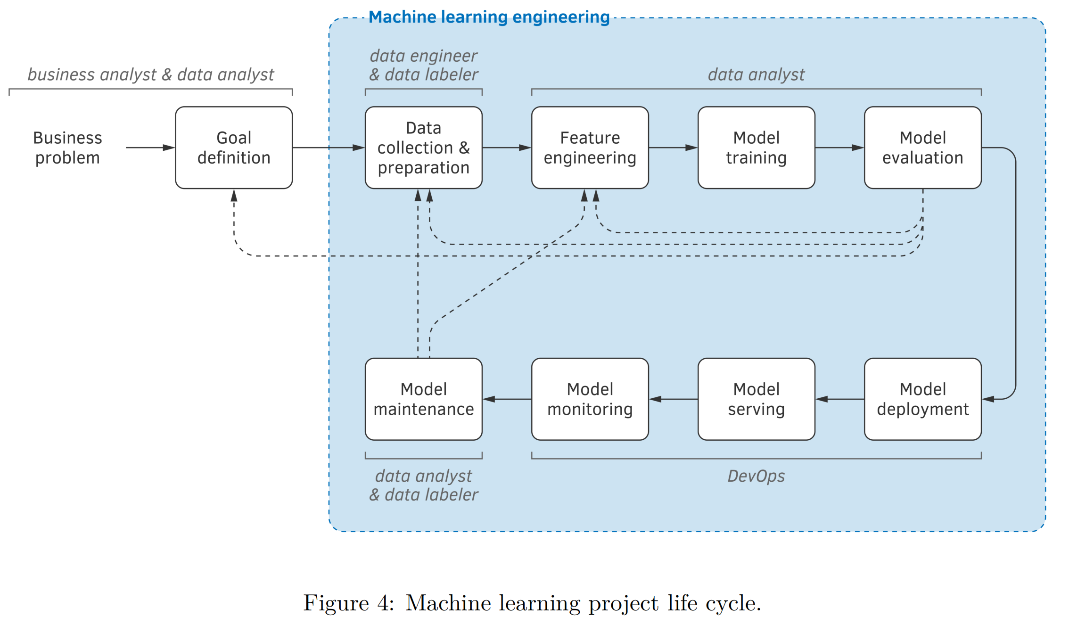
1.7 Machine Learning Project Life Cycle
what a statistical model receives as input;
what it generates as output;
the criteria of acceptable behavior of the model
collect more or different data
revise features

